Slide 1

How to use PowerBI as a free monitoring tool (including 5 reports for SQL Server)

Slide 2
About Me
Emanuele Meazzo
Senior Data Management Consultant
Contact Info:
Email: emanuele.meazzo@gmail.com
Blog: tsql.tech
Linkedin: linkedin.com/in/emanuelemeazzo/
GitHub: github.com/EmanueleMeazzo/tsql.tech-Code-snippets

Slide 3
Agenda
PowerBI Overview
PowerBI Components
How to get data
Dashboard Examples:
FirstRespondersKit Monitoring Dashboard
Xevents Dashboard
Job Information Dashboard
Permission Information Dashboard
Streaming DataSet

Slide 4
PowerBI Overview

Slide 5
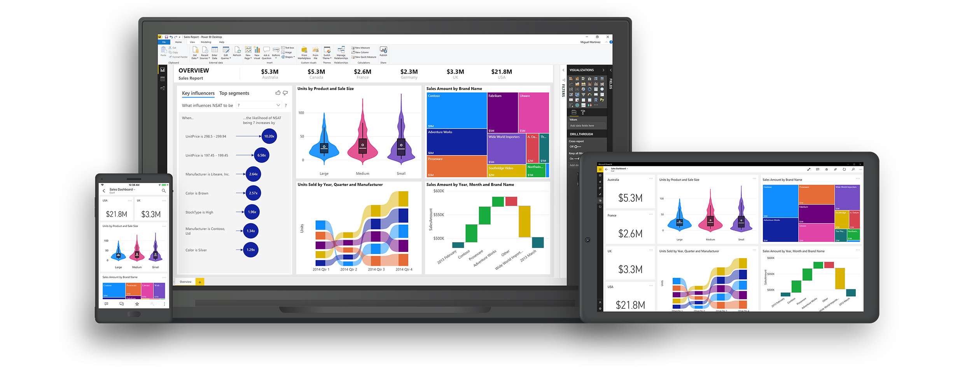
“Power BI is a business analytics service that delivers insights to enable fast, informed decisions.”
We use it as an (improper) monitoring tool because:
It’s free*
It’s on the cloud
It can read from a lot of data sources
It’s easy to create graphs and get insights
It’s improving month by month
It’s based on SSAS Tabular

Slide 6
PowerBI is NOT a monitoring tool
PowerBI is not built to be a monitoring tool but a reporting tool
A proper monitoring tool is tailored on the specific environment to monitor, it already knows where to find the data.
PowerBI is a generic reporting tool that allows you to analyze the data that you provide, coming from anywhere, in order to monitor and visualize it through a report.
There are some limitations that you will learn to hate:
Relations between tables don’t work the way you expect them to
Time granularity is way too coarse for certain indicators
Some trivial operations in SQL are really complex to implement
Etc..

Slide 7
PowerBI IS useful for monitoring
It allows to share performance and health information internally or to third parties without granting access to anything but the report
It allows to give insights to Devs about performance, errors, permissions, etc. without having to teach them how to or having them ask you all the time
It allows to create a centralized view for all the systems to be monitored, as opposed to checking each environment on its own
It allows to create reports templates to distribute within the company (or the community!)

Slide 8
PowerBI IS useful for monitoring
Depending on how you’re going to use it, you can get away without paying any license:
PowerBI Desktop (i.e. creating and viewing reports on your PC) is 100% free
Uploading reports to the PowerBI Cloud in your personal workspace is free
Embedding & Publishing to web is free
Manual and Automatic dataset refreshes are free
Both from Cloud and On-premise sources via a gateway
The gateway can be installed as a service on a dedicated machine for all users or installed on your machine in “personal mode”

Slide 9
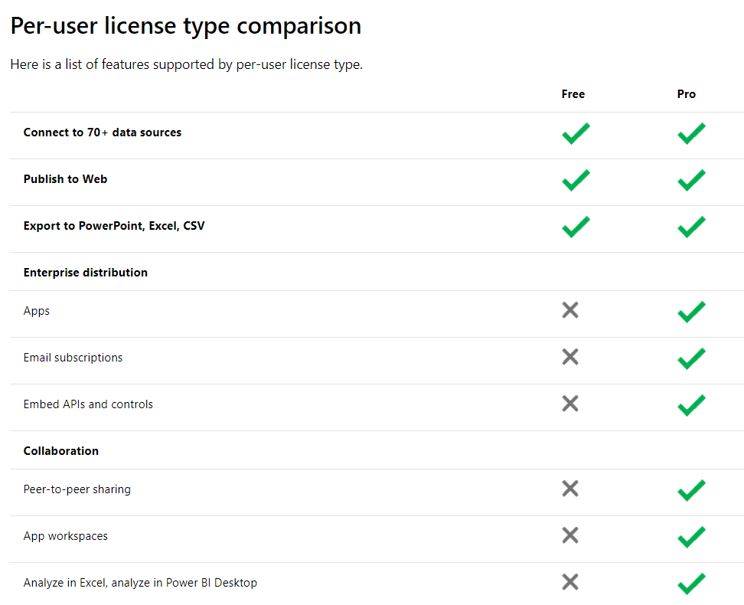
PowerBI IS useful for monitoring
So how does Microsoft makes money over PowerBI if everything is basically free?
With the Enterprise features, of course!
Do you need them? It depends. Do you need them to go out and try immediately what we’re going to see? Nope.
https://powerbi.microsoft.com/en-us/pricing/

Slide 10
PowerBI IS useful for monitoring
At this point I’m already hearing you saying:
“Ok, but why should I use it as opposed as any other free monitoring tool?”
If you can install any proper monitoring tool for your purpose, great, go for it!
But:
When you want to quickly visualize some kind of information
When you cannot modify anything in the system
When you cannot install any third party software
When for third party software you cannot configure proper security rules
When you need to monitor something that has no tools available
When you need to monitor custom processes
When you need an overview of multiple independent systems
This approach is for you!

Slide 11
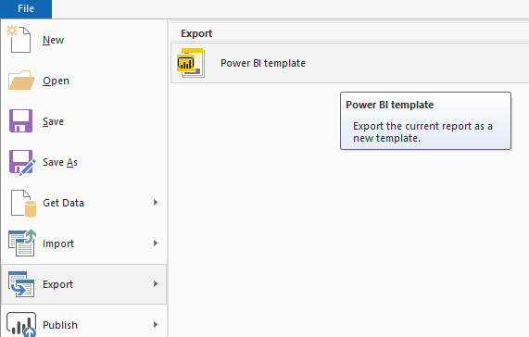
PowerBI is useful for monitoring
Report Templates can be created (*.pbit)
They contain all the modelling info, but none of the data/connections
You can open a template, enter your connection details and you’re ready to go

Slide 12
PowerBI Components

Slide 13
PowerBI Glossary
Report: The pbix file you’re working on
Report Page: Each page of the report (can be hidden or visible)
Visual: Each graphical element in a report page
Workspace: A container for dashboards, reports and datasets
Dashboard: Visuals from different reports can be displayed in a single place, called dashboard.
App: The contents of a workspace can be (selectively) bundled in an app that can be distributed

Slide 14
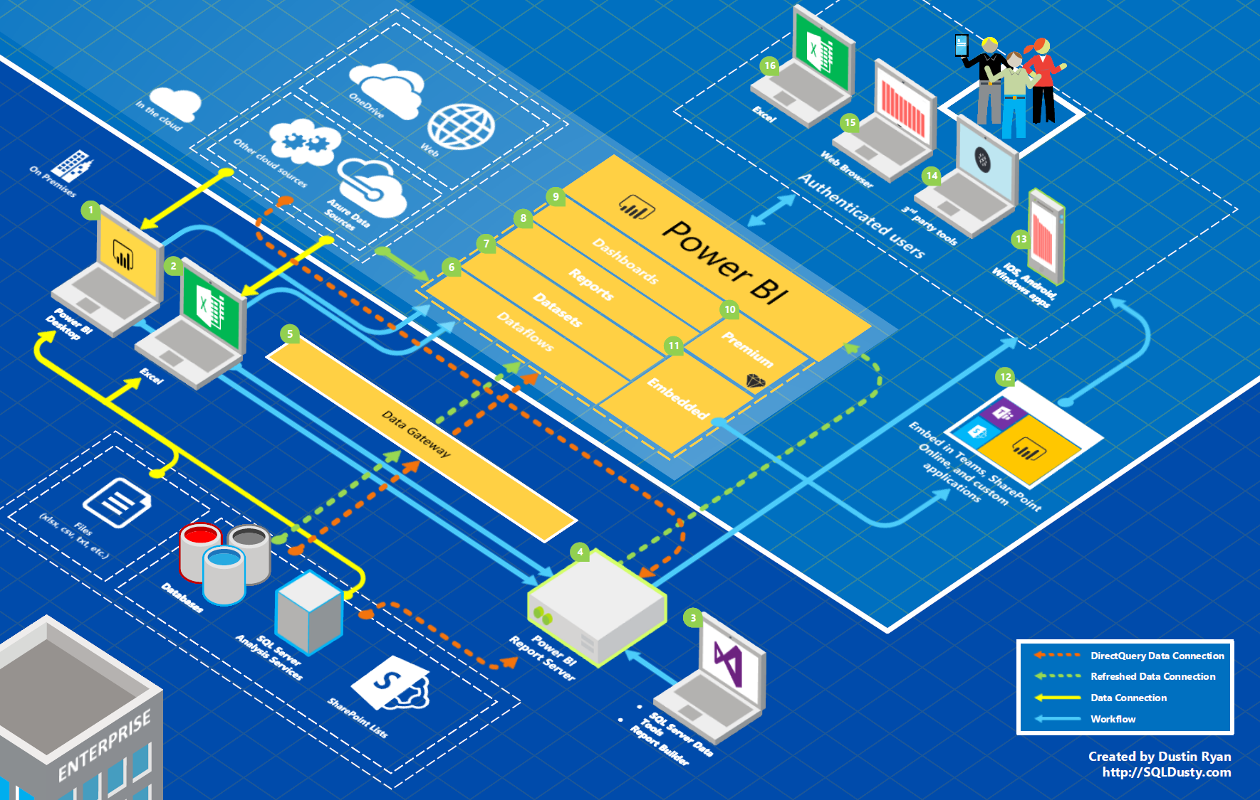
PowerBI Elements
Dashboards are online elements of a workspace that can contain visuals from any of the reports in the workspace
A report can contain multiple pages, each pages containing multiple visuals (table, graphs, etc…)
PowerBI Desktop is the Windows tool to build reports
A Dataset is basically a SSAS Tabular model where the imported data is loaded
Databases, files, online services, etc… are called Data Sources

Slide 15
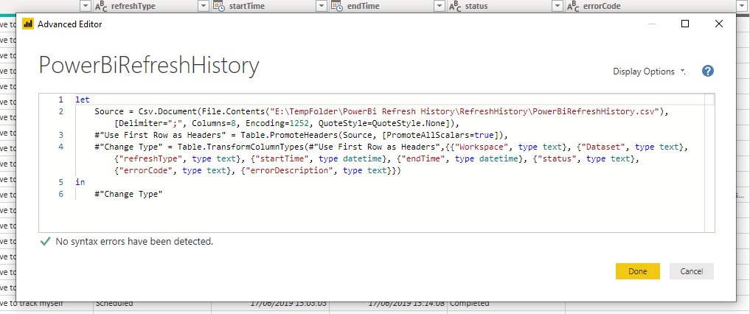
The PowerBI Language(s)
M (aka Power Query Formula Language)
Especially if using PowerBI as we are, we can get away not writing M directly 99% of the time
The GUI contains almost all the actions available; in fact, the actual, full, M query is hidden in a submenu.
Kind of an ETL Language, it gets you from the source data to the model Table
If you’re an Excel Power user, you probably already know (or at least use unknowingly) M

Slide 16
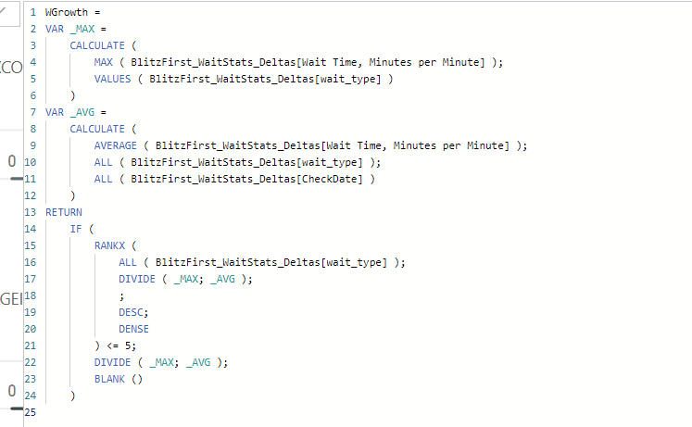
The PowerBI Language(s)
DAX
The actual data analysis language for PowerBI, also used for business analysis in SSAS Tabular & Excel PowerPivot

Slide 17
Storage Modes
Import:
Imported tables are cached. Queries submitted to the Power BI dataset that return data from Import tables can be fulfilled only from cached data.
DataSet refreshes can be scheduled, but there is a hard limit of 8 scheduled refreshes per day (no limit on manual refreshes)
DirectQuery:
Tables aren't cached. Queries that you submit to the Power BI and that return data from DirectQuery tables can be fulfilled only by executing on-demand queries to the data source. Queries that you submit to the data source use the query language for that data source - for example, SQL.

Slide 18
PowerBI limitations as a monitoring tool
Relationships
Relationships work best when one-to-many or one-to-one and unidirectional
Bidirectional relationships can introduce cycles and can be blocked in the model
There can be only one active relationship between one table and another (multiple keys)
Engine
The dataset is a SSAS Tabular model, based on columnar database engine, good for aggregations, not so good for row by row operations.
DAX syntax/logic is non straightforward coming from SQL and has a somewhat steep learning curve

Slide 19
Getting Data

Slide 20
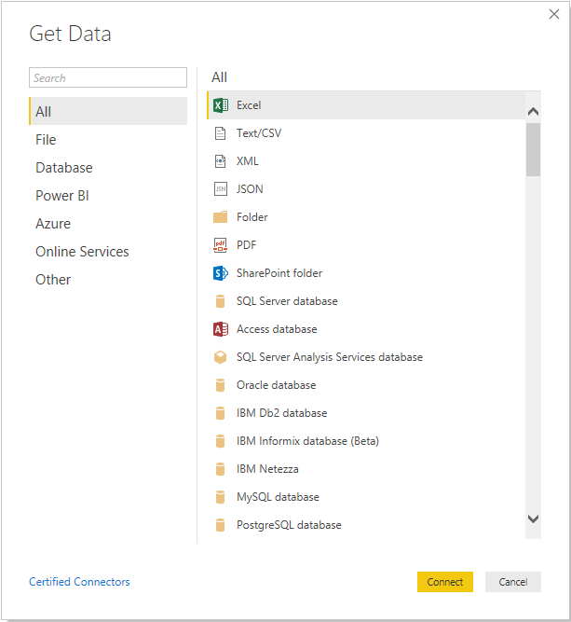
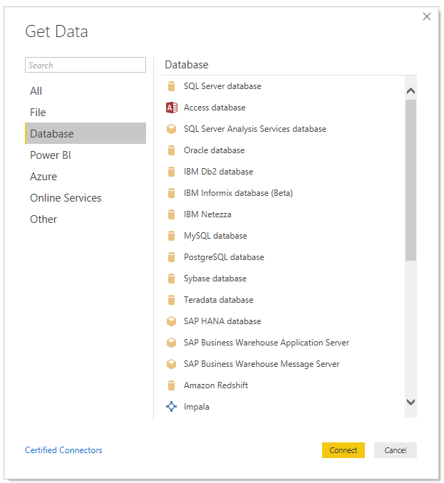
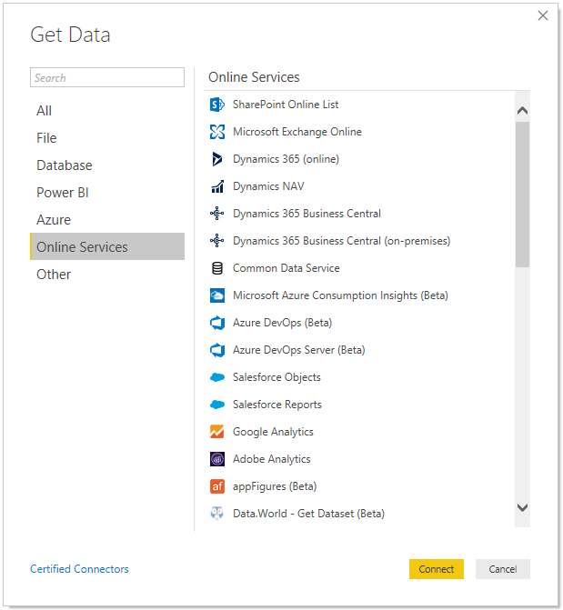
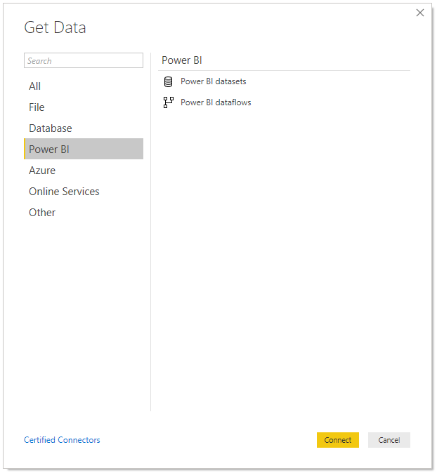
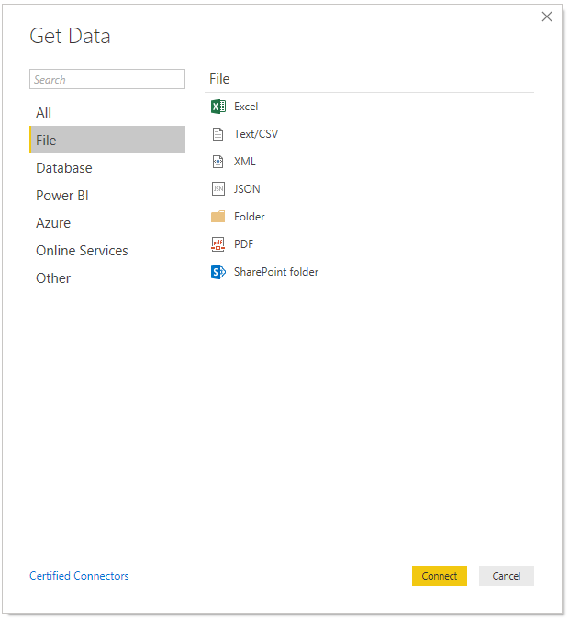
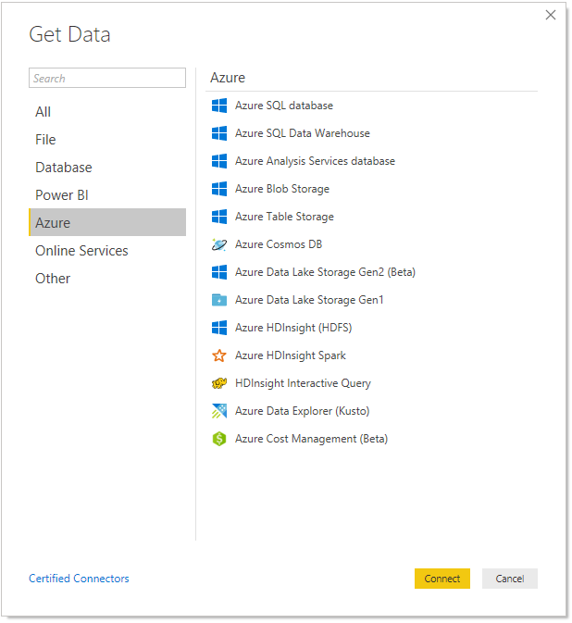
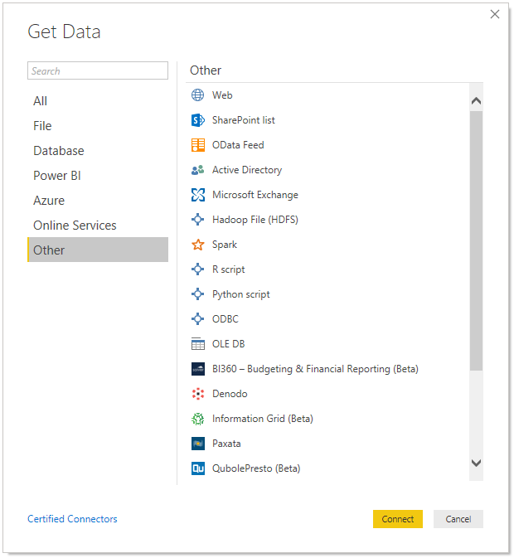
There are tens of connectors to allow getting data from heterogeneous sources
You can find the list of PowerBI Connectors here

Slide 21
Finally, hands on! Let’s create a report from scratch

Slide 22
Premade Examples

Slide 23
Disclaimer
In this section a few examples of PowerBI reports for SQL Server will be shown
The point is to explain the concept via examples, which could then be applied to any platform
Since we’re at a SQL Server event, I’ll be focusing and providing material for this platform

Slide 24
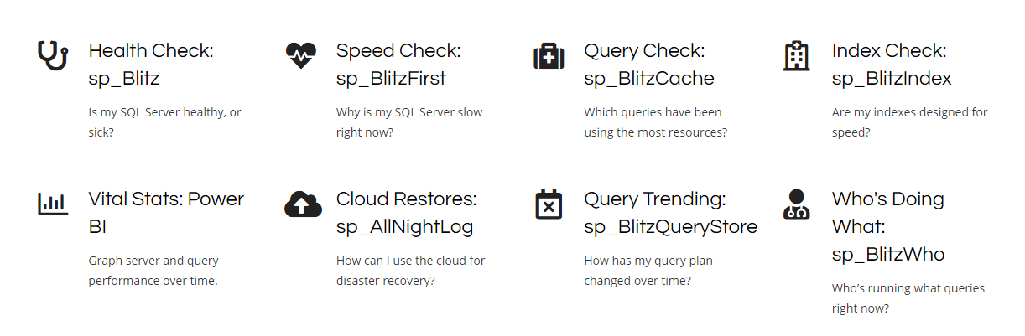
FirstReponders Kit PowerBI Report
The FirstResponders Kit is an open source collection of procedures that allows SQL Server DBAs to monitor and manage their instances faster, leveraging all the relevant SQL Server DMVs
The PowerBI report is technically deprecated (issues with GitHub collaboration for a binary)
However:
It will work as-is until the schema of the table/views in the kit is changed (probably never)
I’ll continue to support and evolve it over my repository (as I was it’s major contributor, I grew attached to it)

Slide 25
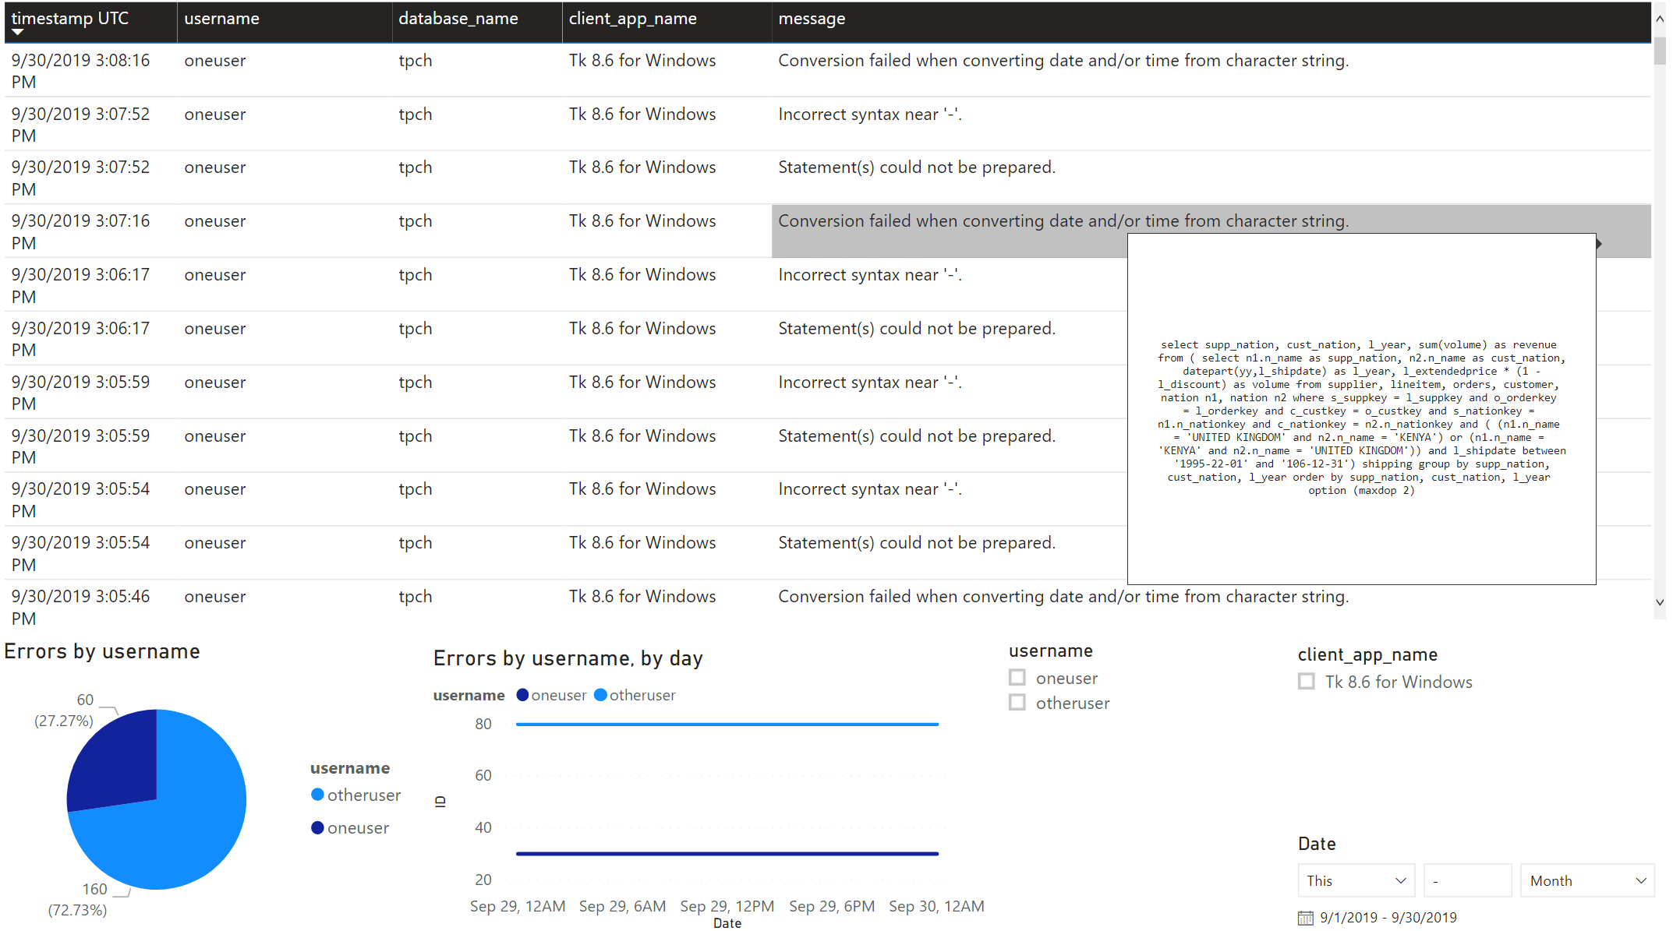
Xevents Dashboard (track query errors)

Slide 26
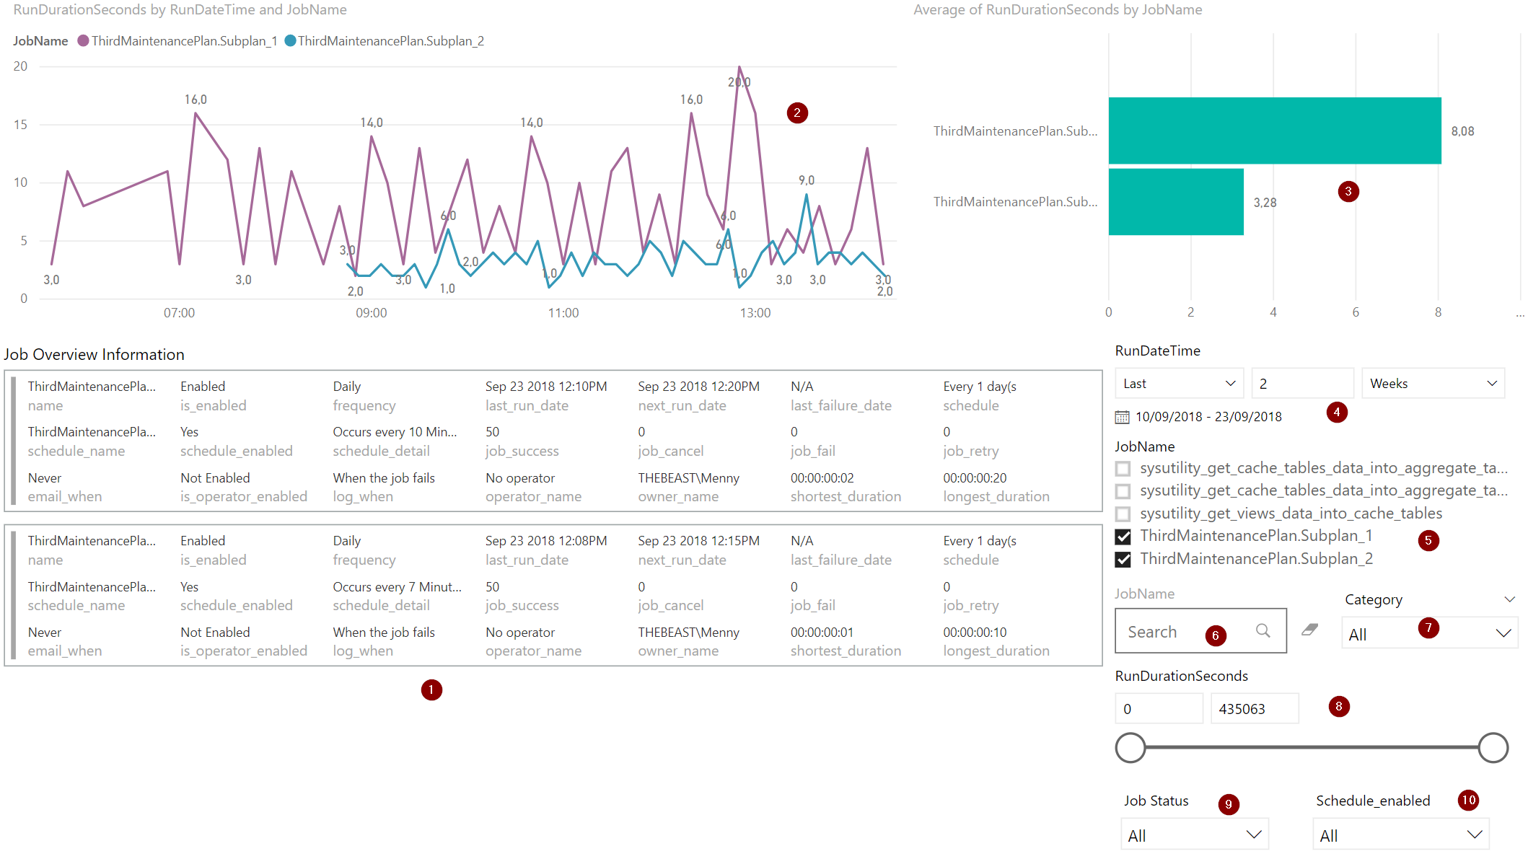
Job Information Dashboard
https://tsql.tech/a-powerbi-report-for-sql-server-agent-jobs/

Slide 27
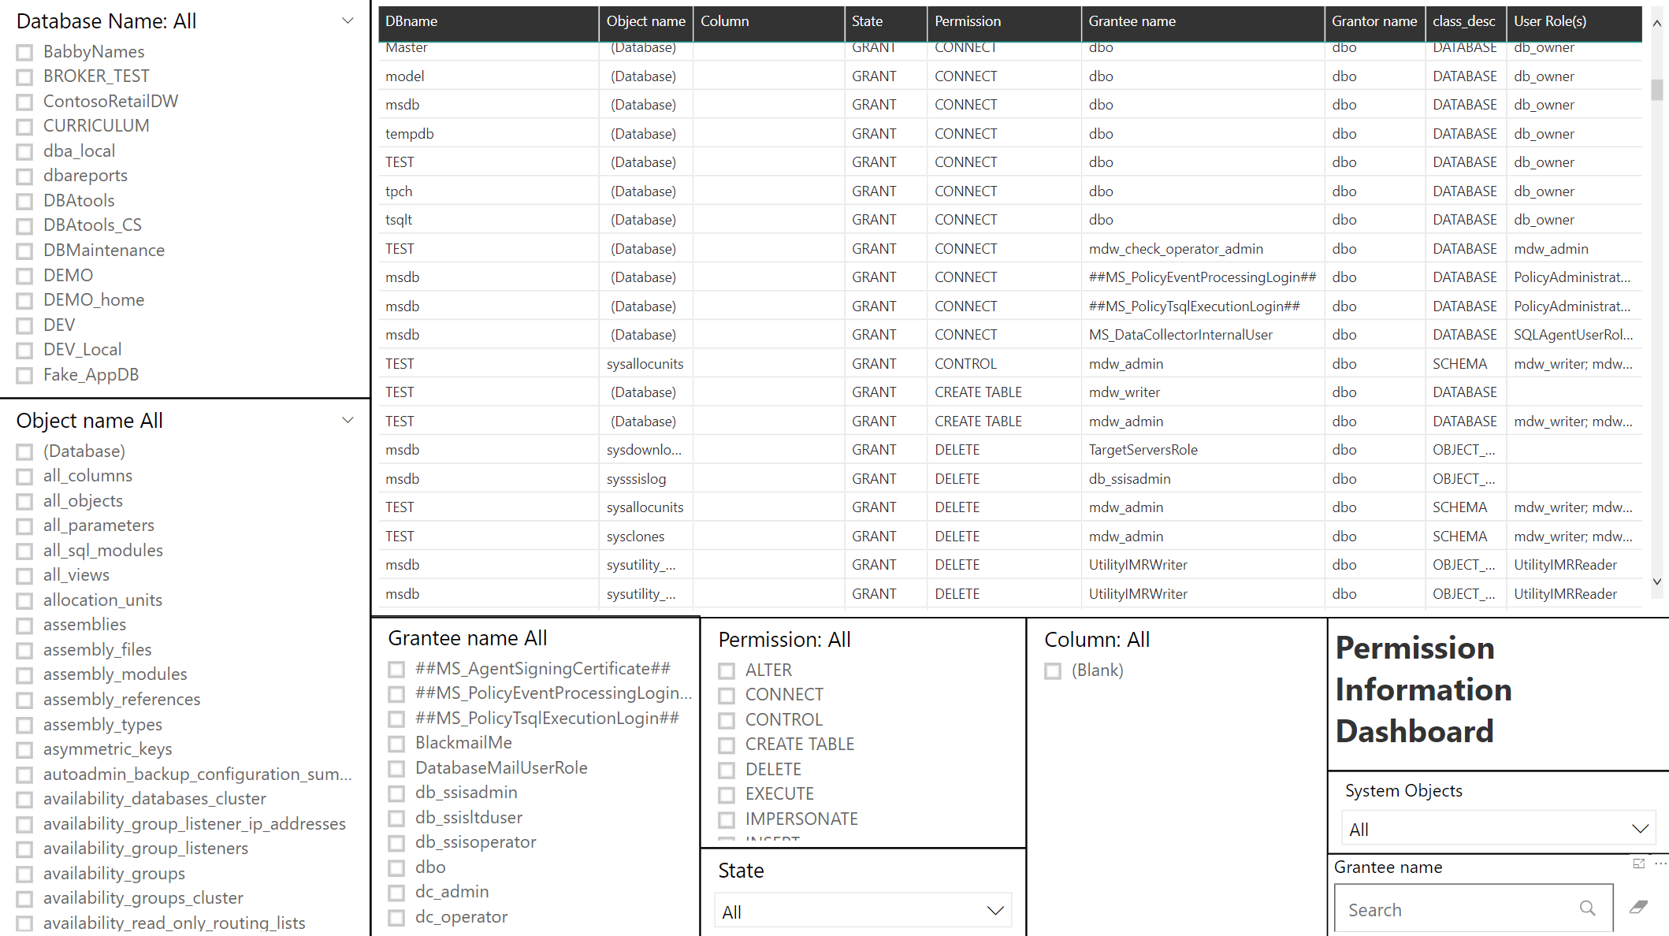
Permission Information Dashboard
https://tsql.tech/a-sql-server-permission-report-in-powerbi/

Slide 28
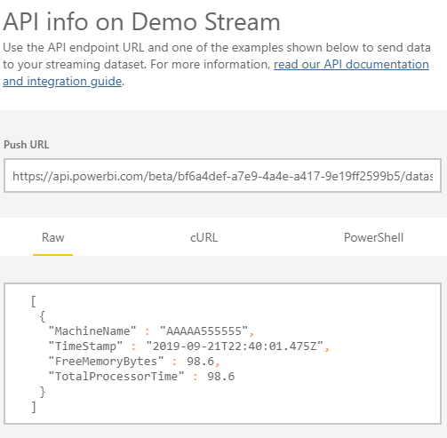
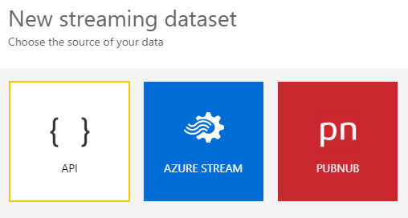
Streaming Dataset
Data can be live streamed to a Dashboard

Slide 29
Thanks!
For any question feel free to contact me in any way you feel comfortable with
Contact details are on the 2nd slide!

